Slide 1
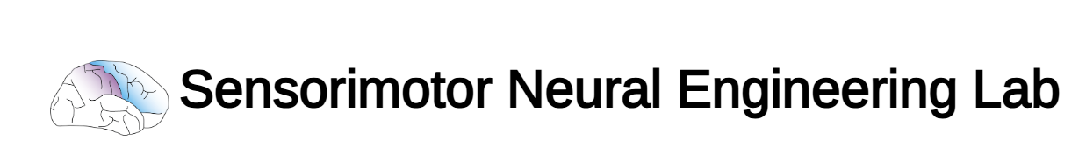
Phil, Zeyad, Tom Update
3/17/25

Slide 2
Contents
Overall System Architecture - Phil
Applicator - Zeyad
Performance of Strain Sensors - Tom

Slide 3
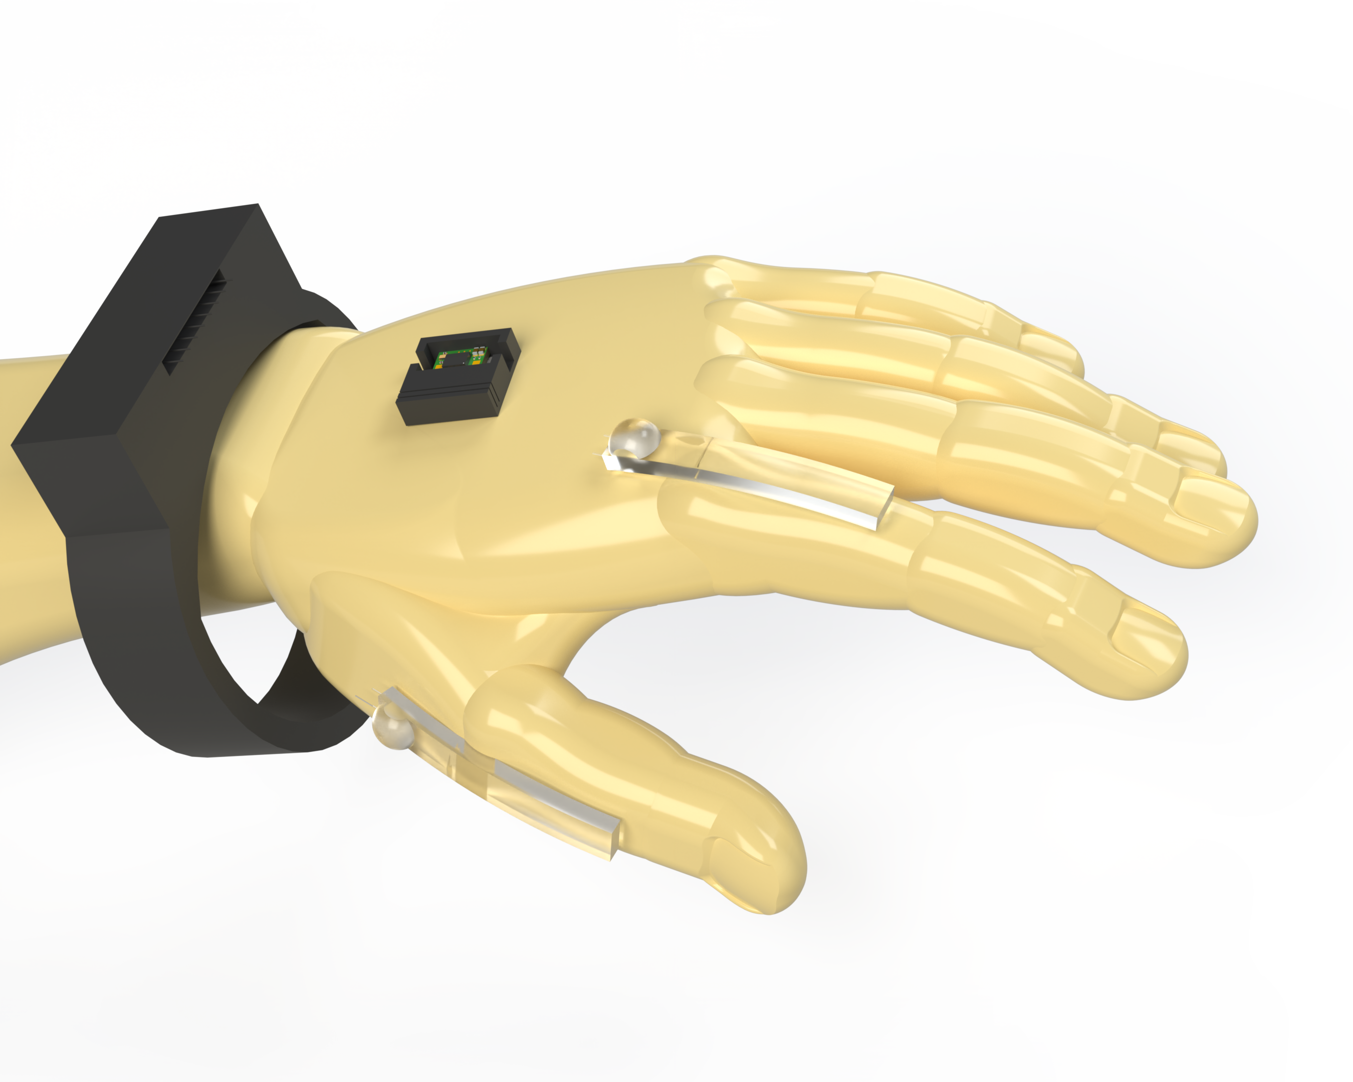
System Architecture

Slide 4
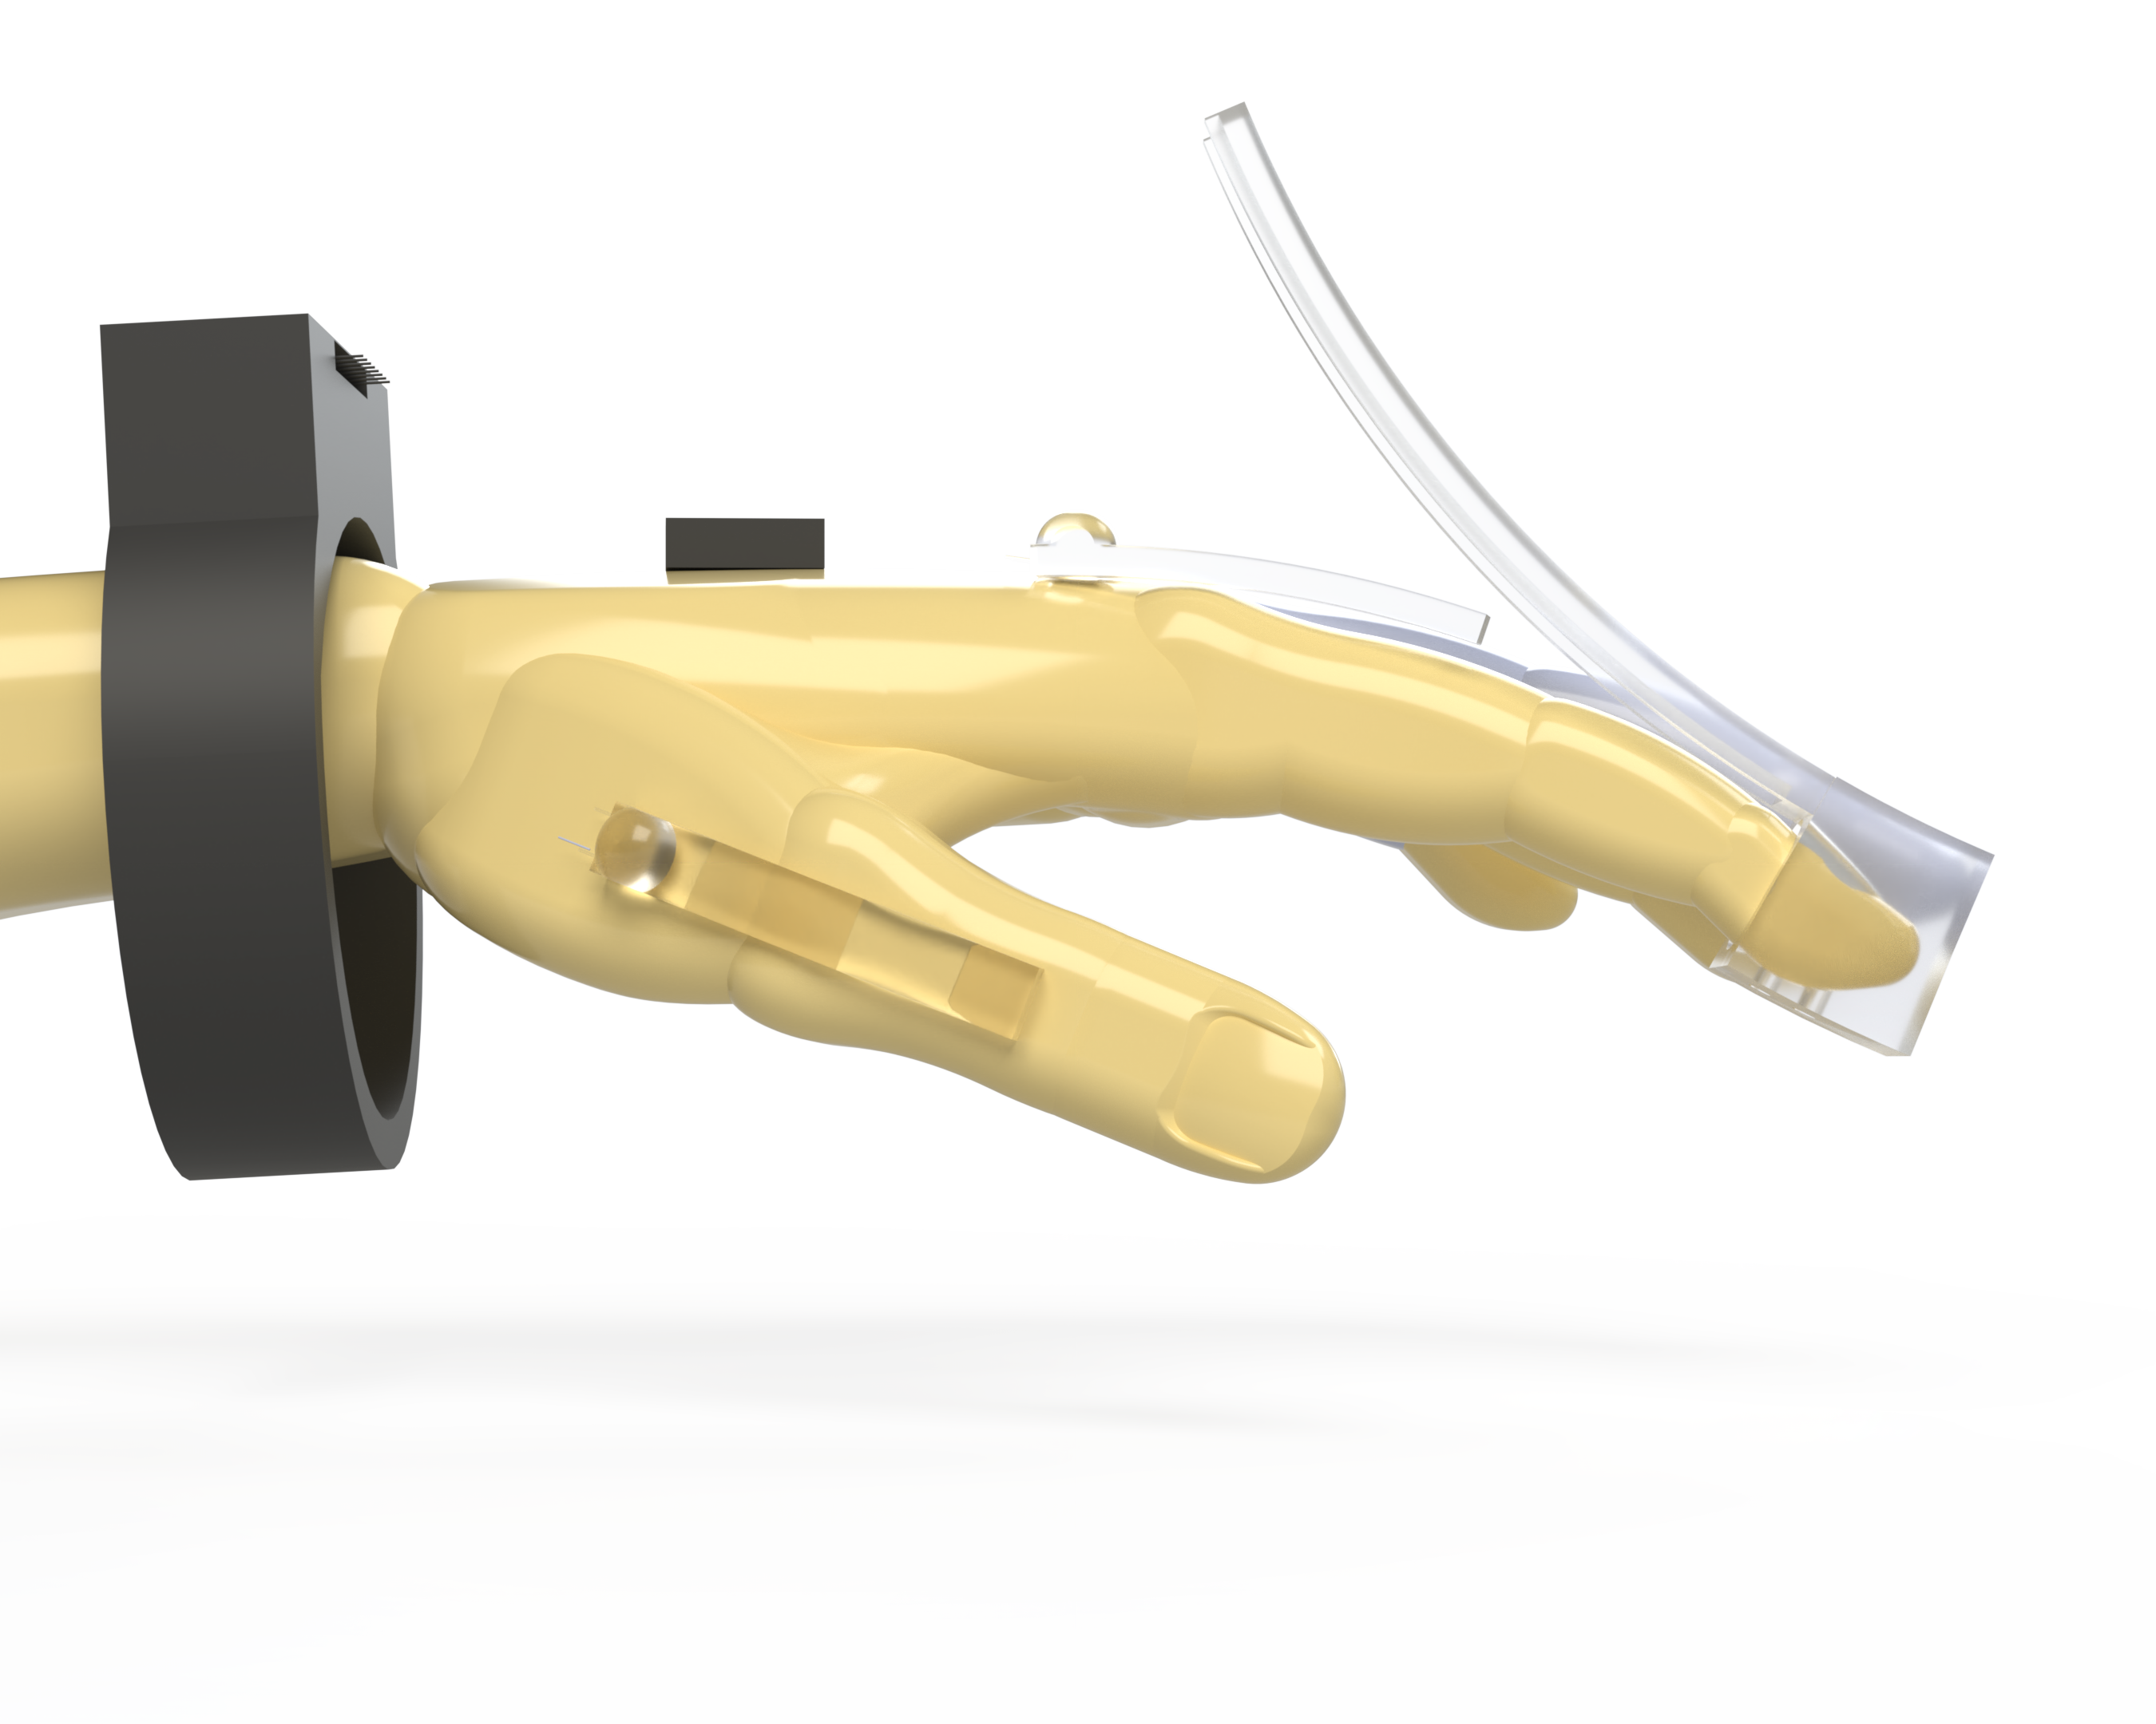
Strain Sensors with Applicator

Slide 5
Strain Sensors

Slide 6
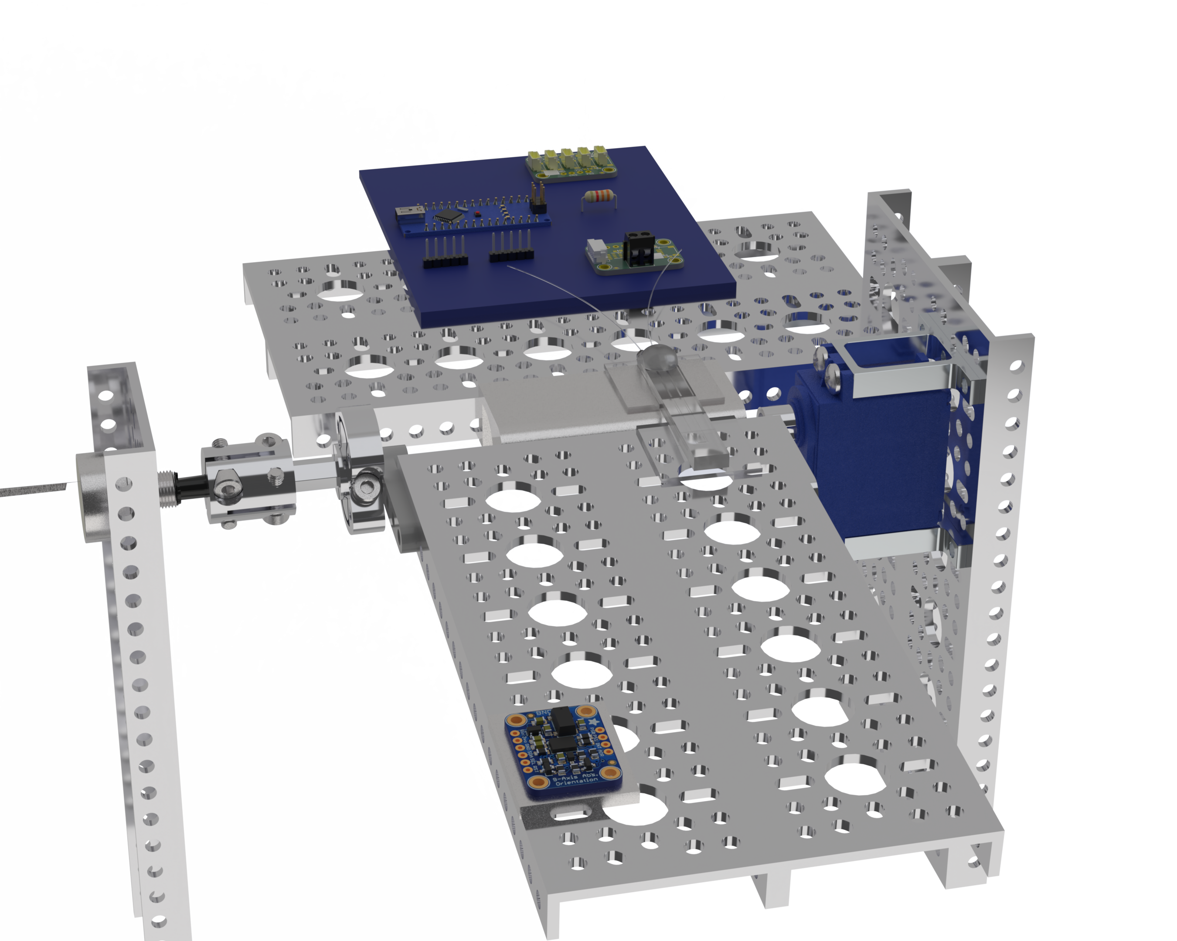
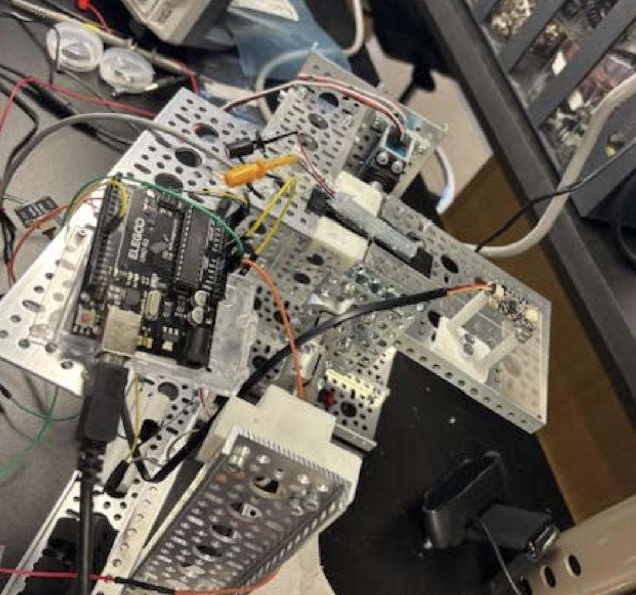
Auto Bender “Controlled” Testing
Hall Effect Rotary Encoder 0-320 deg
MCP3421 ADC
Servo
IMU

Slide 7
Circuit 4: 65.5 mA through Divider
50 ohm (2 precision 100 ohm in parallel)
- Would sometimes have to change this resistance to avoid clipping on ADC
Strain Gauge (0.4 ohm – 1.2 ohm)
GND
3.3V 800mA Linear Voltage Regulator - LD1117-3.3 TO-220
w/ in and out 10 uF electrolytic caps for stability
GND
x 76
LMC6492 Non-Inverting Opamp (75kohm/1kohm)
GND
2.048V ref (LM4040)
~1.99V to 5.87V
x 2
MCP3421 I2C (16 bit resolution)
Arduino Uno I2C

Slide 8
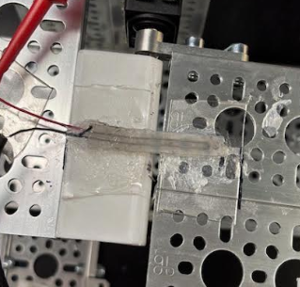

Slide 9
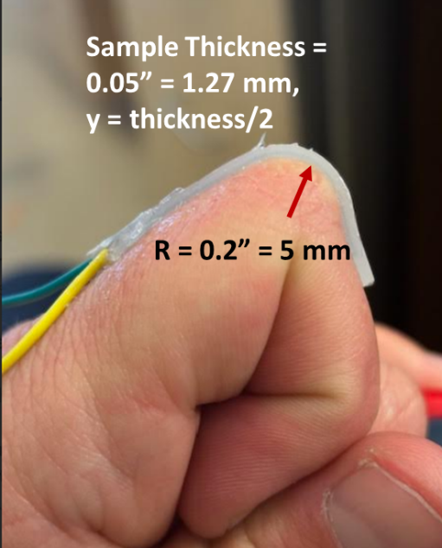
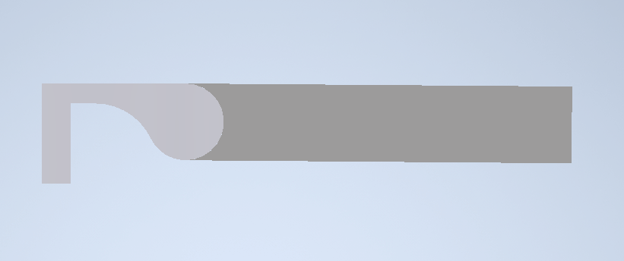
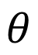
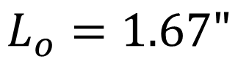
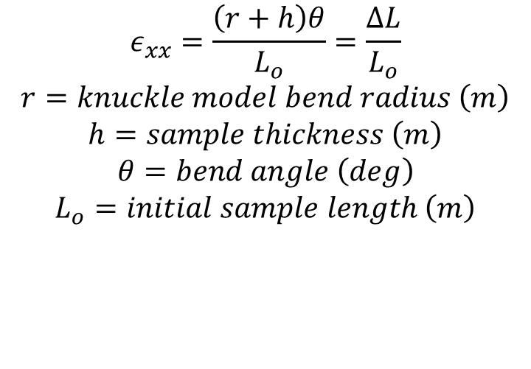
Human Knuckle Model
$$L_{o}=1.67"$$
h = 0.05” (1.27 mm)
r = 0.125”
$$θ$$
Measured Strain on finger with sample abs_100
(using strings)
~ 0.1677 or 16.8%
$$ε_{xx}=\frac{\left(r+h\right)θ}{L_{o}}=\frac{ΔL}{L_{o}}$$
$$r=knuckle model bend radius \left(m\right)$$
$$h=sample thickness \left(m\right)$$
$$θ=bend angle \left(deg\right)$$
$$L_{o}=initial sample length \left(m\right)$$

Slide 10
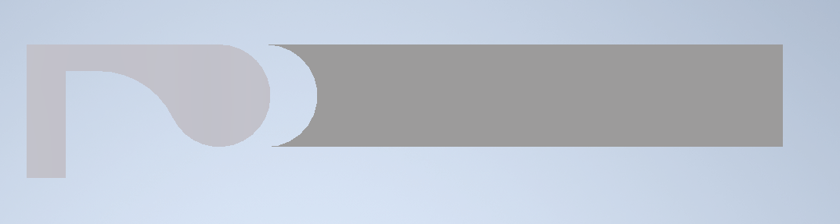
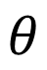
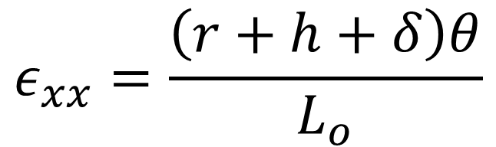
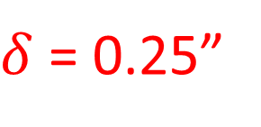
Auto Bender Model
h
r
$δ$ = 0.25”
$$θ$$
Measured Strain on sample abs_100 on AutoBender
~ 0.4 or 40%
$$ε_{xx}=\frac{\left(r+h+δ\right)θ}{L_{o}}$$

Slide 11
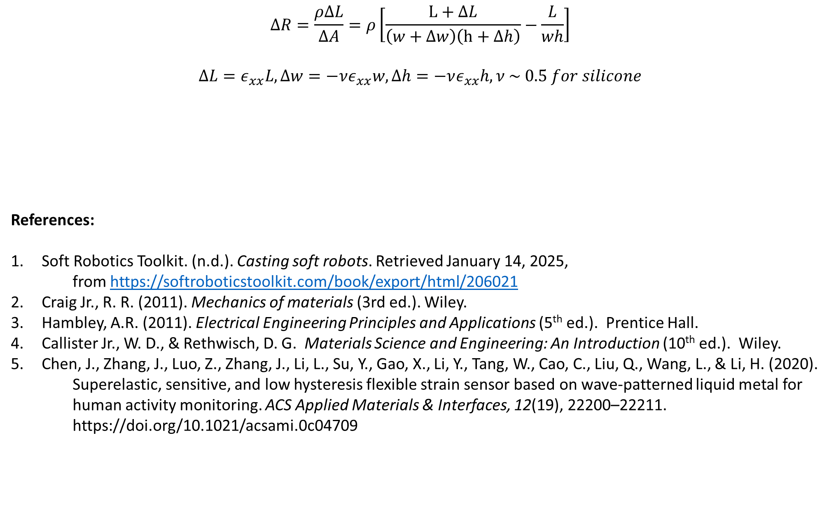
$$ΔR=\frac{ρΔL}{ΔA}=ρ\left[\frac{L+ΔL}{\left(w+Δw\right)\left(h+Δh\right)}−\frac{L}{wh}\right]$$
$$ΔL=ε_{xx}L, Δw=−νε_{xx}w, Δh=−νε_{xx}h, ν \sim 0.5 for silicone$$
References:
Soft Robotics Toolkit. (n.d.). Casting soft robots. Retrieved January 14, 2025,
from https://softroboticstoolkit.com/book/export/html/206021
Craig Jr., R. R. (2011). Mechanics of materials (3rd ed.). Wiley.
Hambley, A.R. (2011). Electrical Engineering Principles and Applications (5th ed.). Prentice Hall.
Callister Jr., W. D., & Rethwisch, D. G. Materials Science and Engineering: An Introduction (10th ed.). Wiley.
Chen, J., Zhang, J., Luo, Z., Zhang, J., Li, L., Su, Y., Gao, X., Li, Y., Tang, W., Cao, C., Liu, Q., Wang, L., & Li, H. (2020).
Superelastic, sensitive, and low hysteresis flexible strain sensor based on wave-patterned liquid metal for
human activity monitoring. ACS Applied Materials & Interfaces, 12(19), 22200–22211.
https://doi.org/10.1021/acsami.0c04709
$$ΔR=\frac{ρLε_{xx}}{wh}\left[\frac{8−ε_{xx}}{{\left(2−ε_{xx}\right)}^{2}}\right]→\frac{ΔR}{R_{o}}=\frac{ρLε_{xx}}{whR_{o}}\left[\frac{8−ε_{xx}}{{\left(2−ε_{xx}\right)}^{2}}\right]=normalized resistance where R_{o}is initial resistance$$

Slide 12
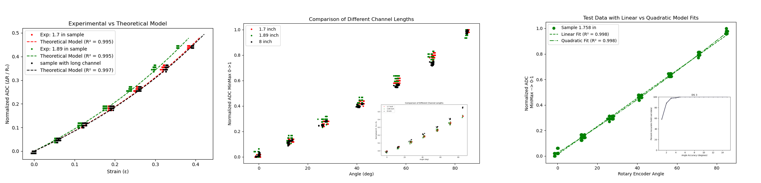
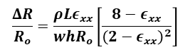
Theoretical Modeling and Curve Fitting
$$\frac{ΔR}{R_{o}}=\frac{ρLε_{xx}}{whR_{o}}\left[\frac{8−ε_{xx}}{{\left(2−ε_{xx}\right)}^{2}}\right]$$

Slide 13
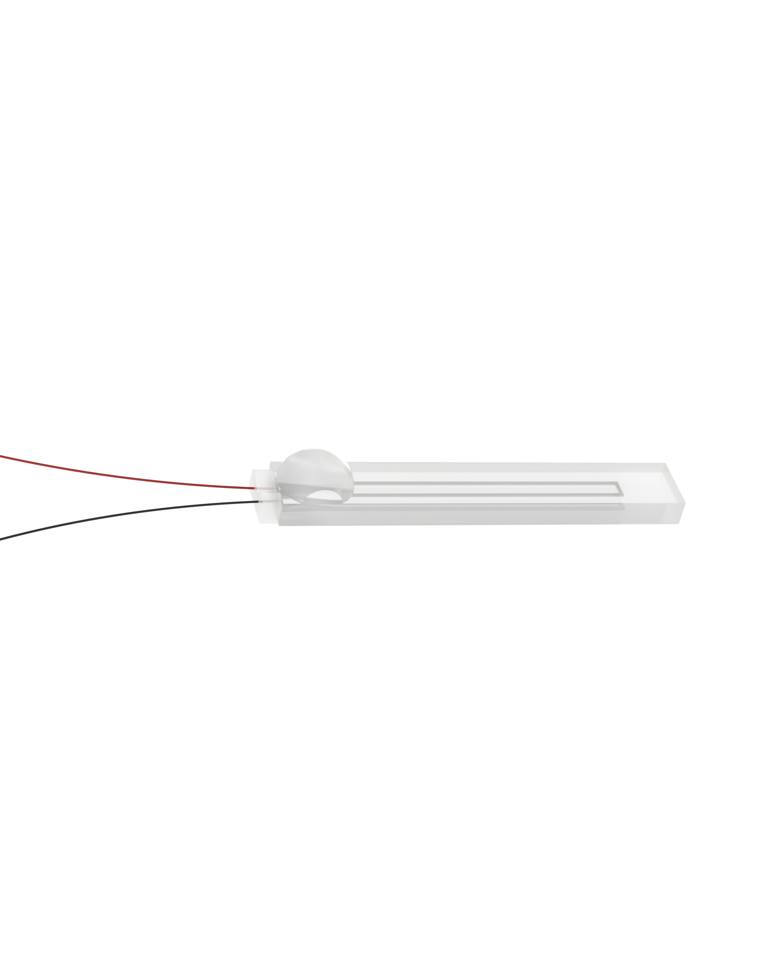
Auto Bender Varying Geometry

Slide 14
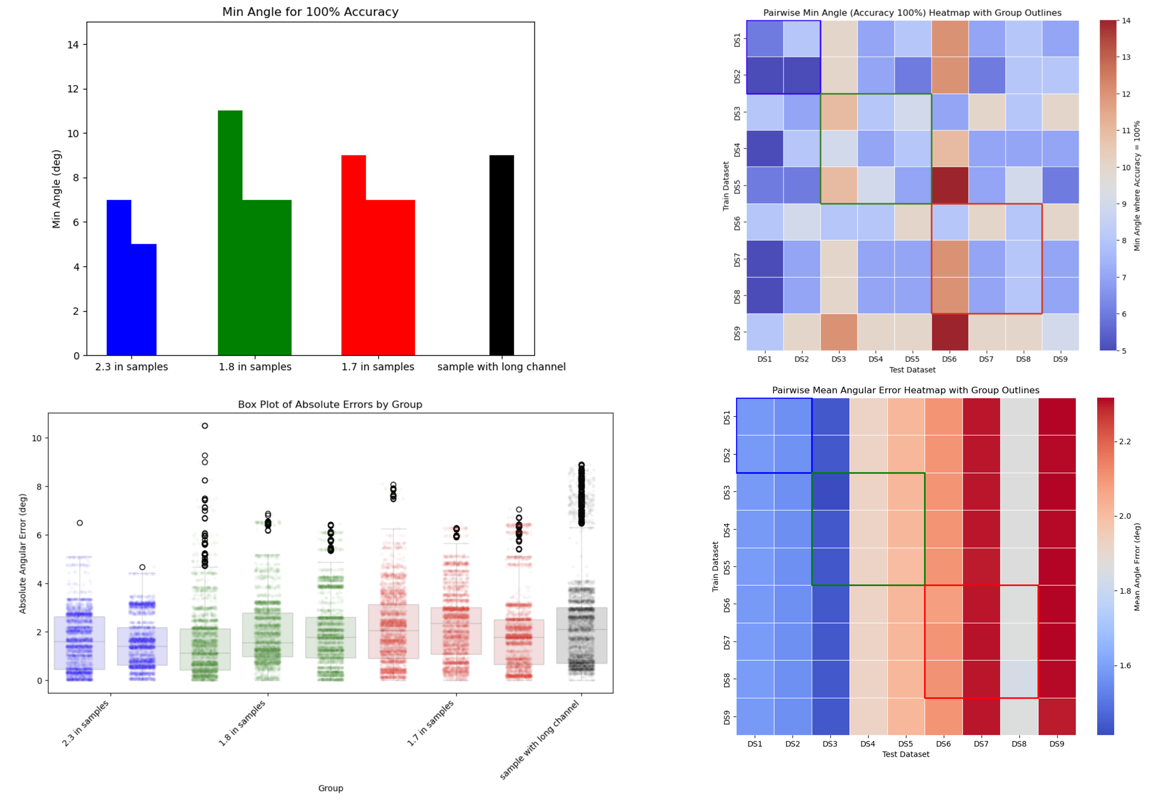
Auto Bender Varying Geometry
3 samples
4 samples
1 sample
2 samples

Slide 15
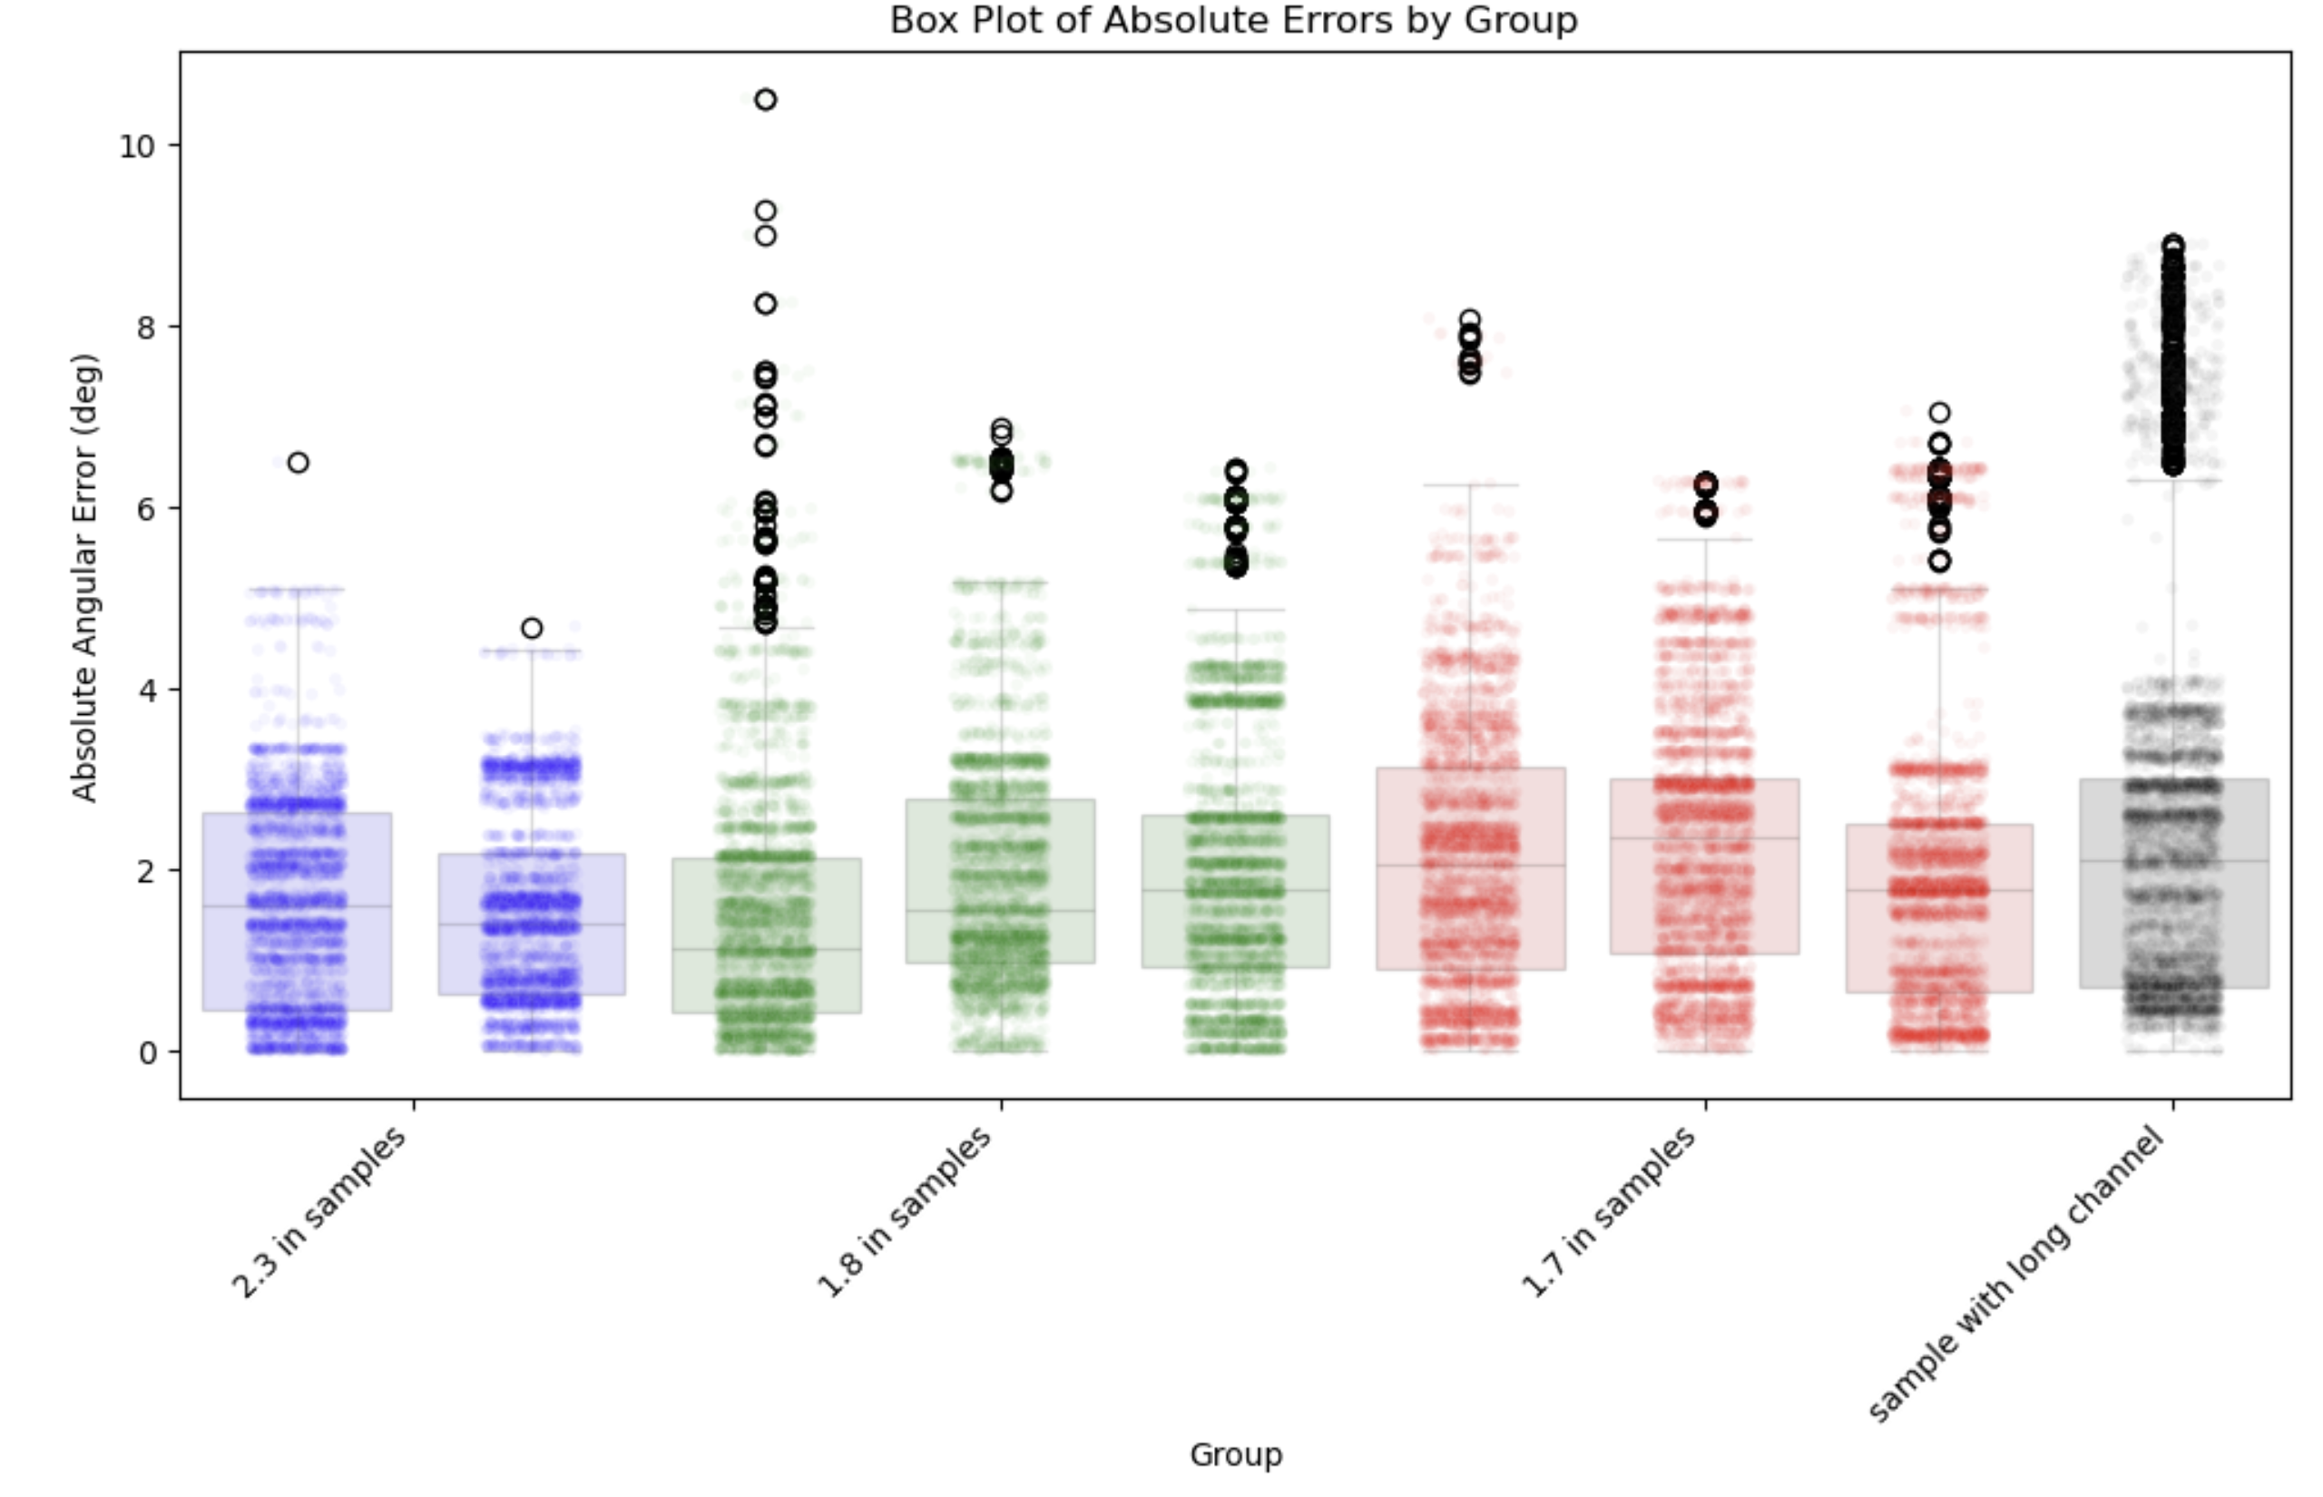
a. Performs 10-fold cross-validation by splitting 1 sample worth of data into 10 parts
b. Each fold uses 9/10 of the data for training and 1/10 for testing
c. Predicts angles for held out data points
d. Computes angular error abs(y_predict – y_test) across all folds
Q3+1.5×IQR
75% Percentile
Median
25% Percentile
Q1-1.5×IQR

Slide 16
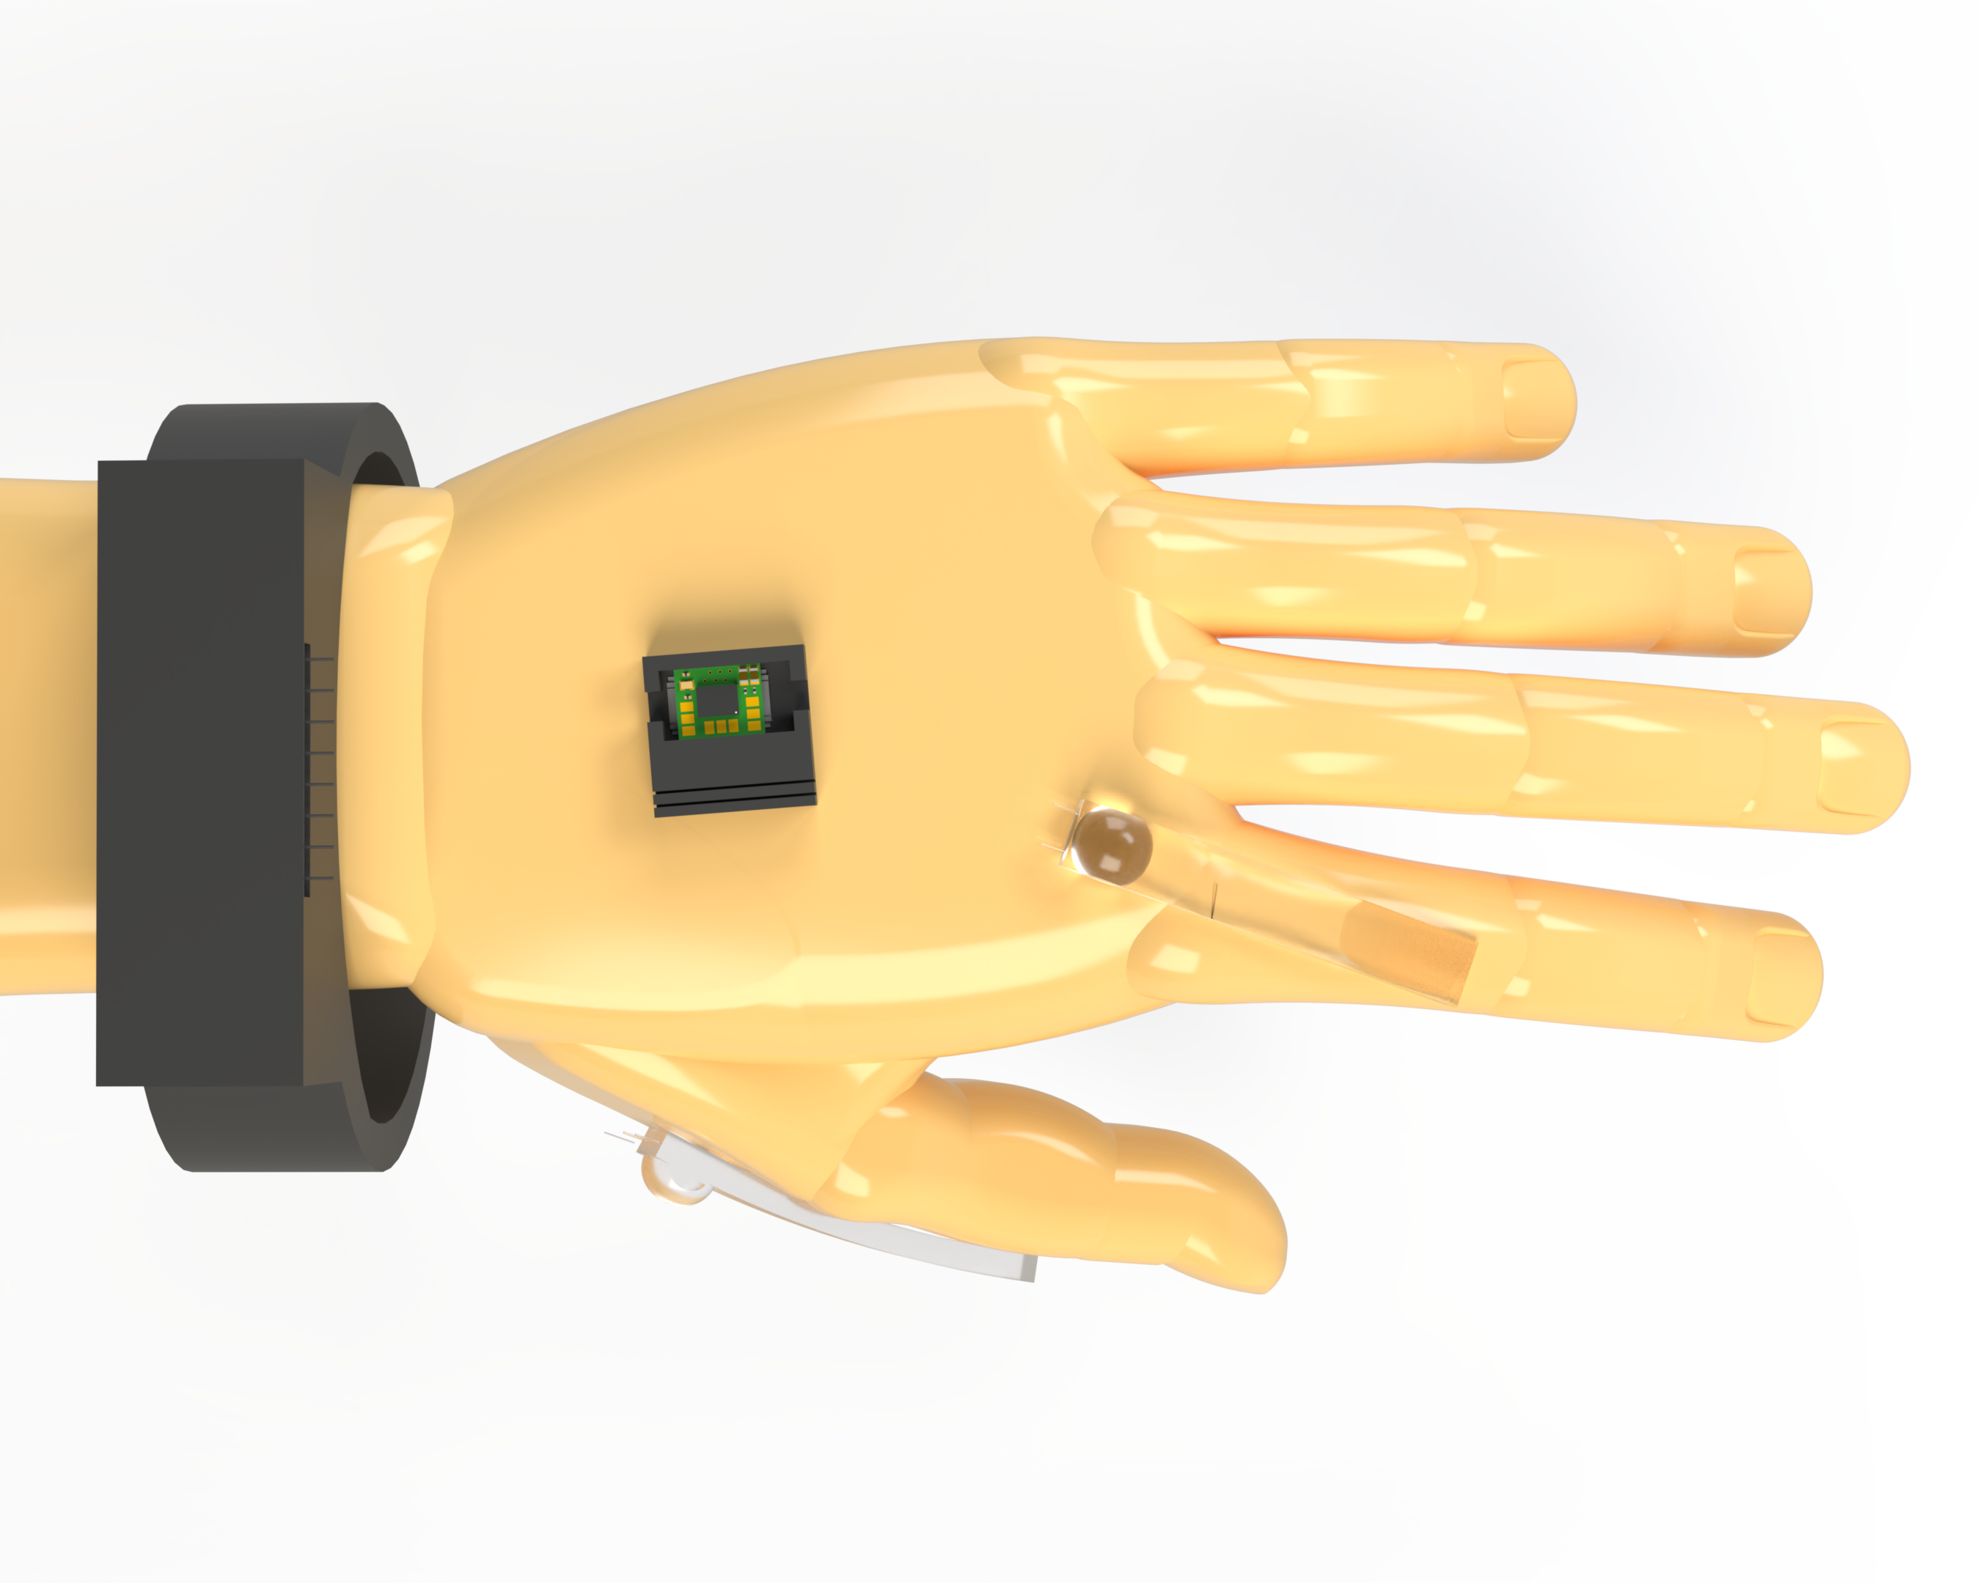
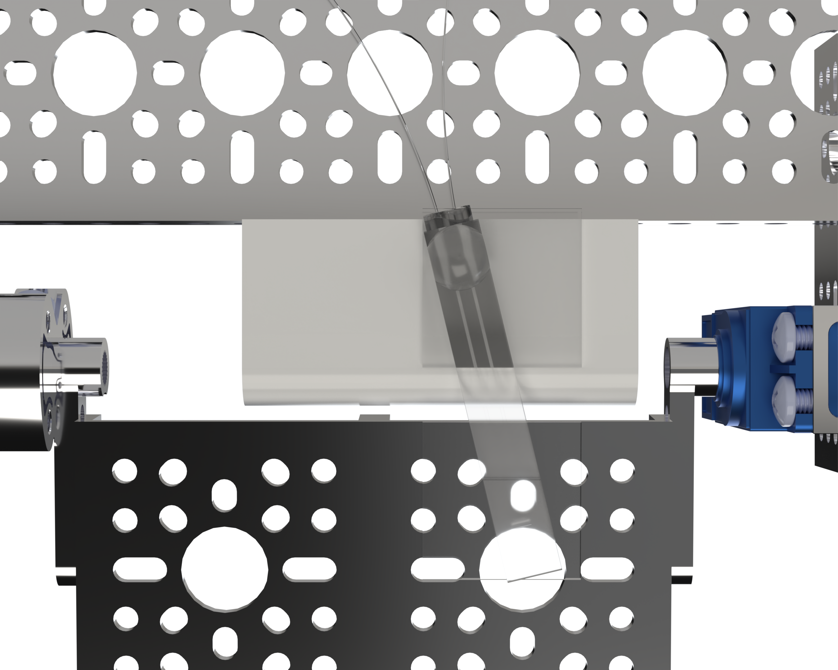
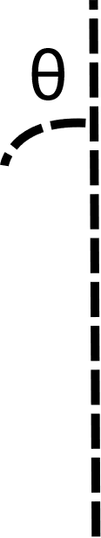
Auto Bender Misalignment Testing

Slide 17
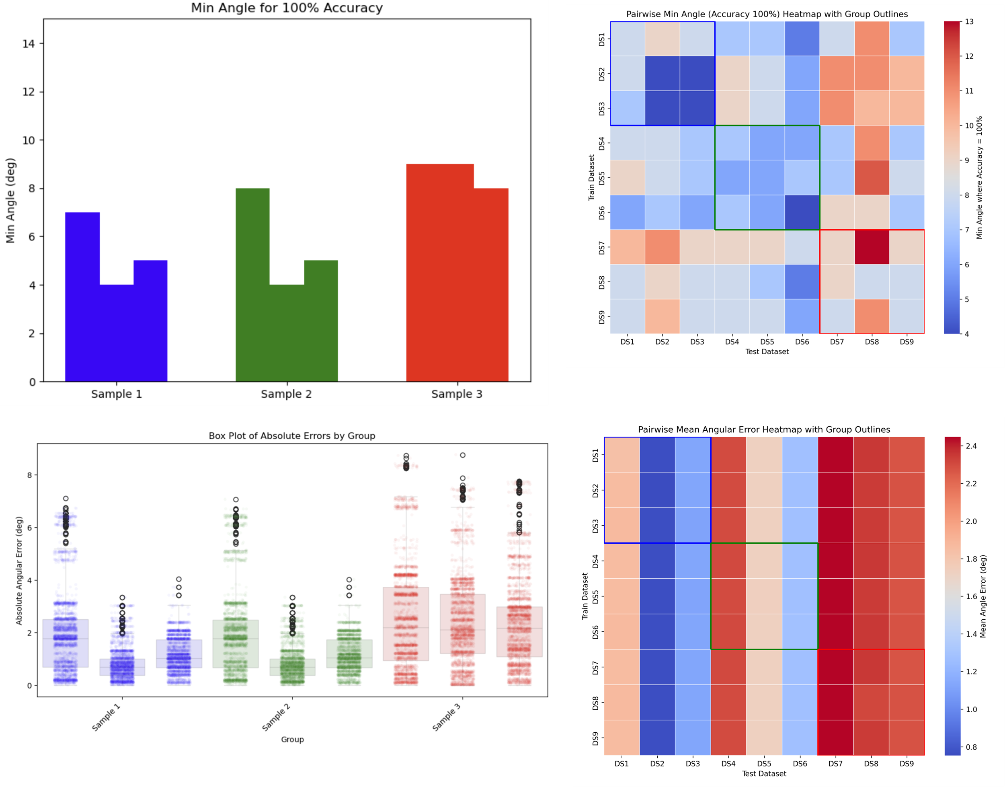
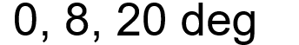
Auto Bender Misalignment Testing

Slide 18
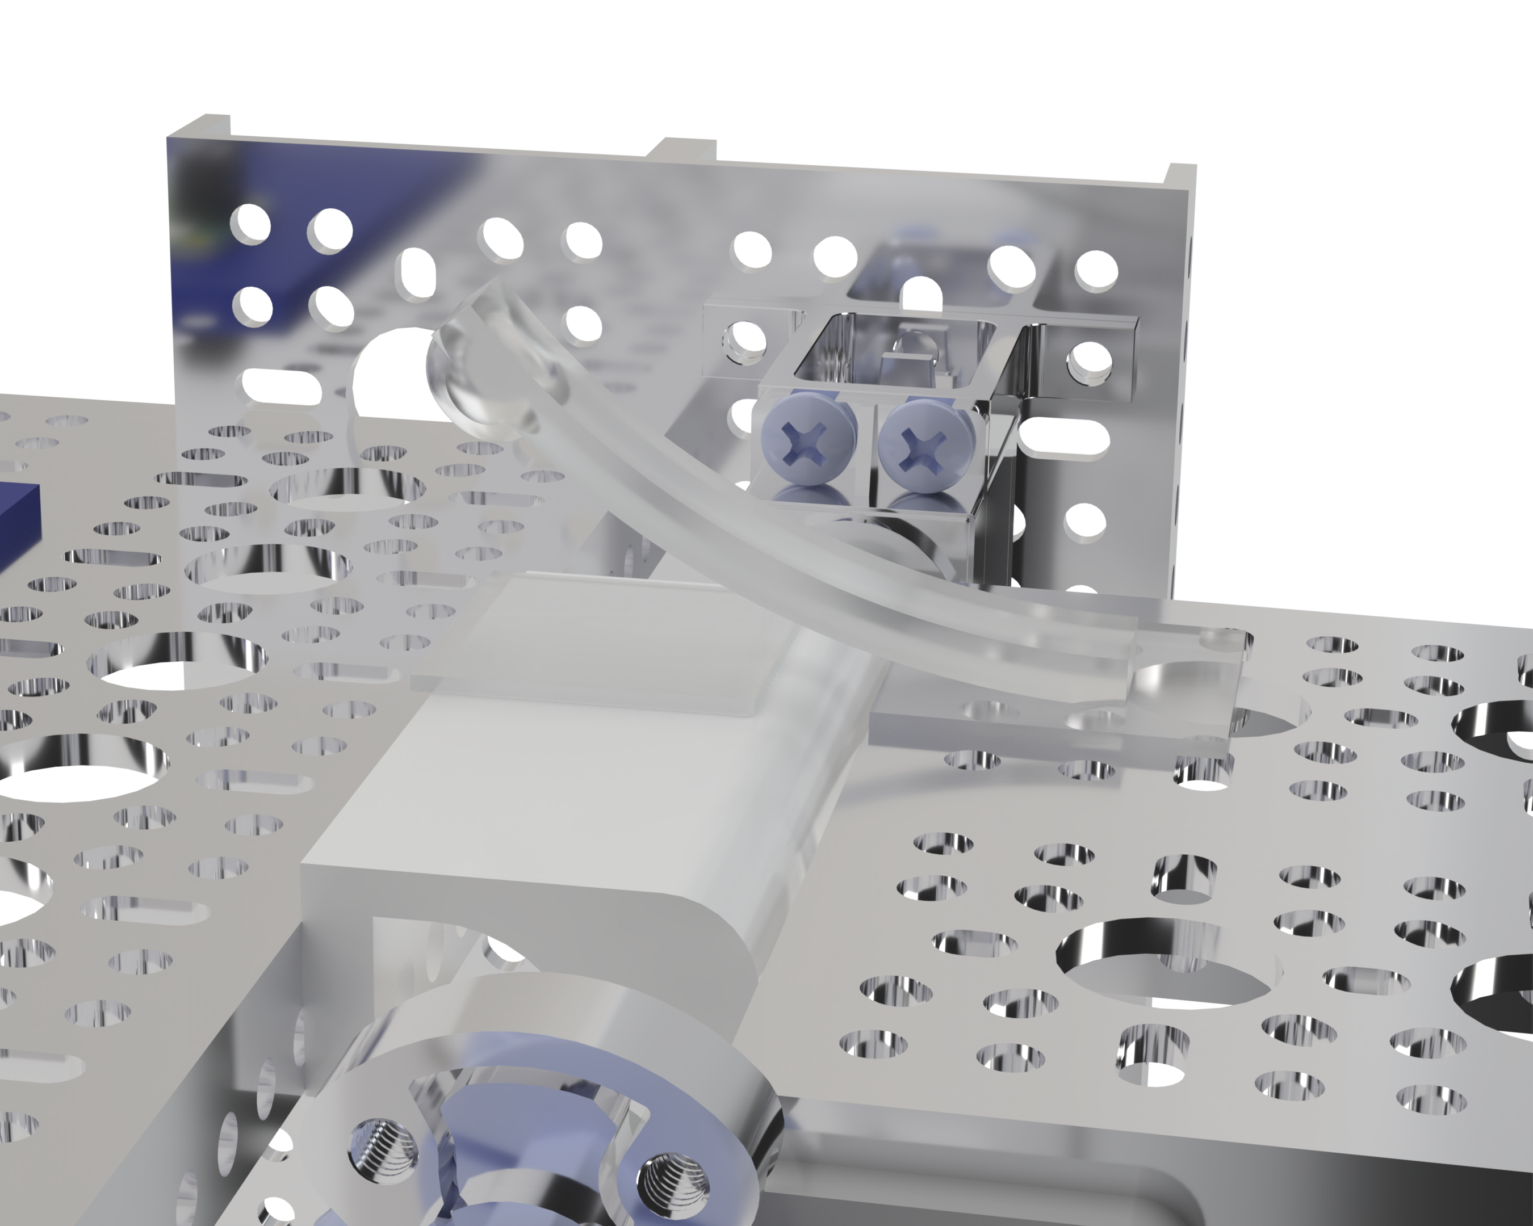
Auto Bender Reapplication Testing
Reapplication 4x per sample

Slide 19
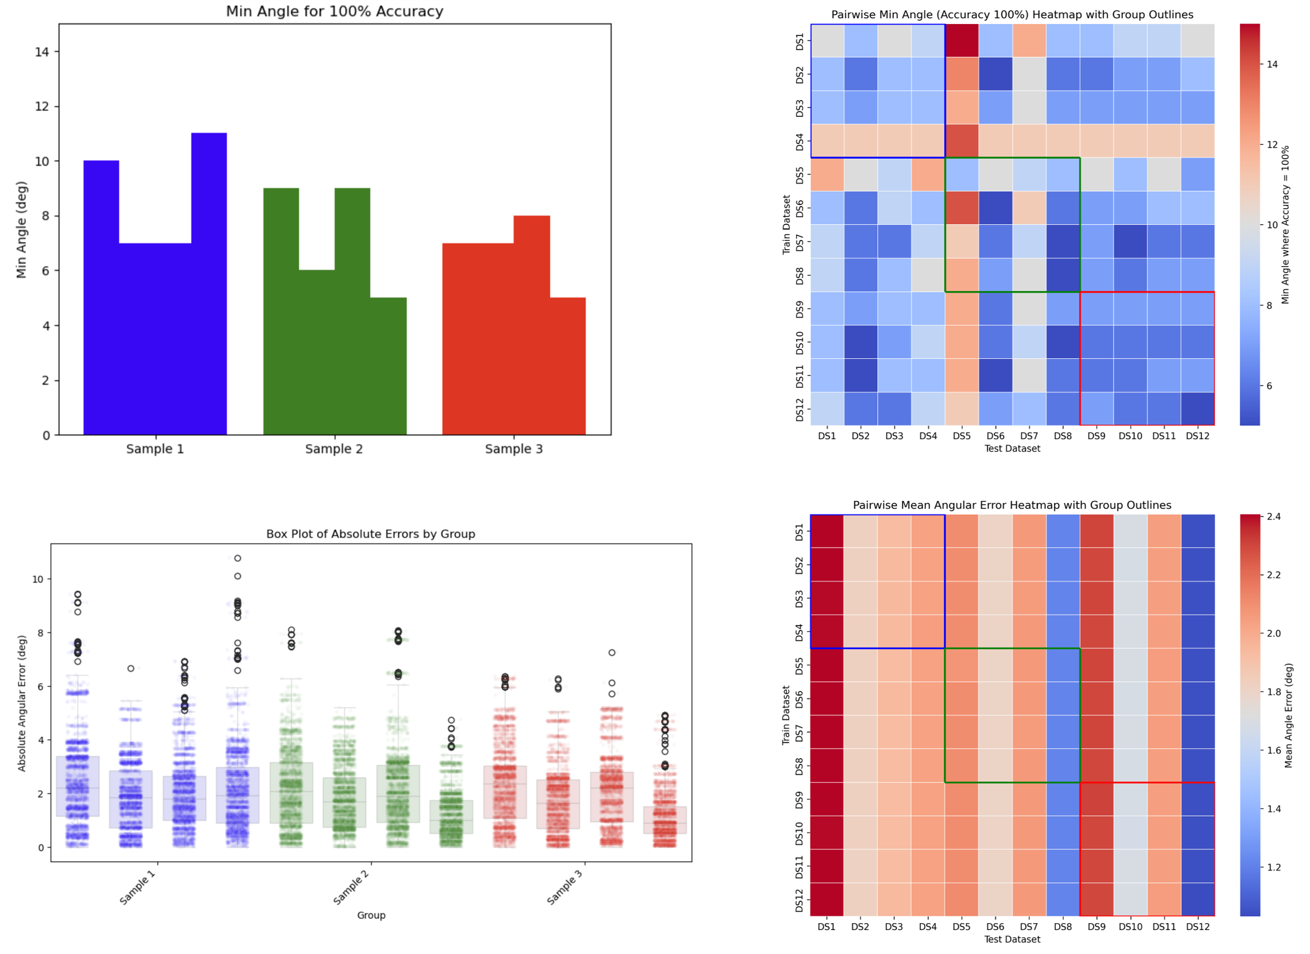
Auto Bender Reapplication Testing

Slide 20
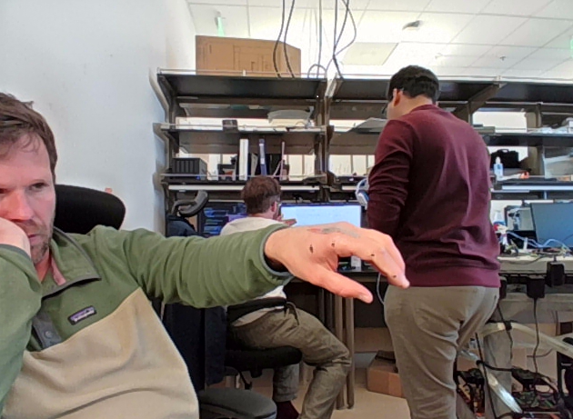
Next Steps: Redo Tests on Hand
DeepLabCut
~ 300 Frames
Extract Bend Angles per Frame
Compare bend angles to calibrated strain sensor

Slide 21
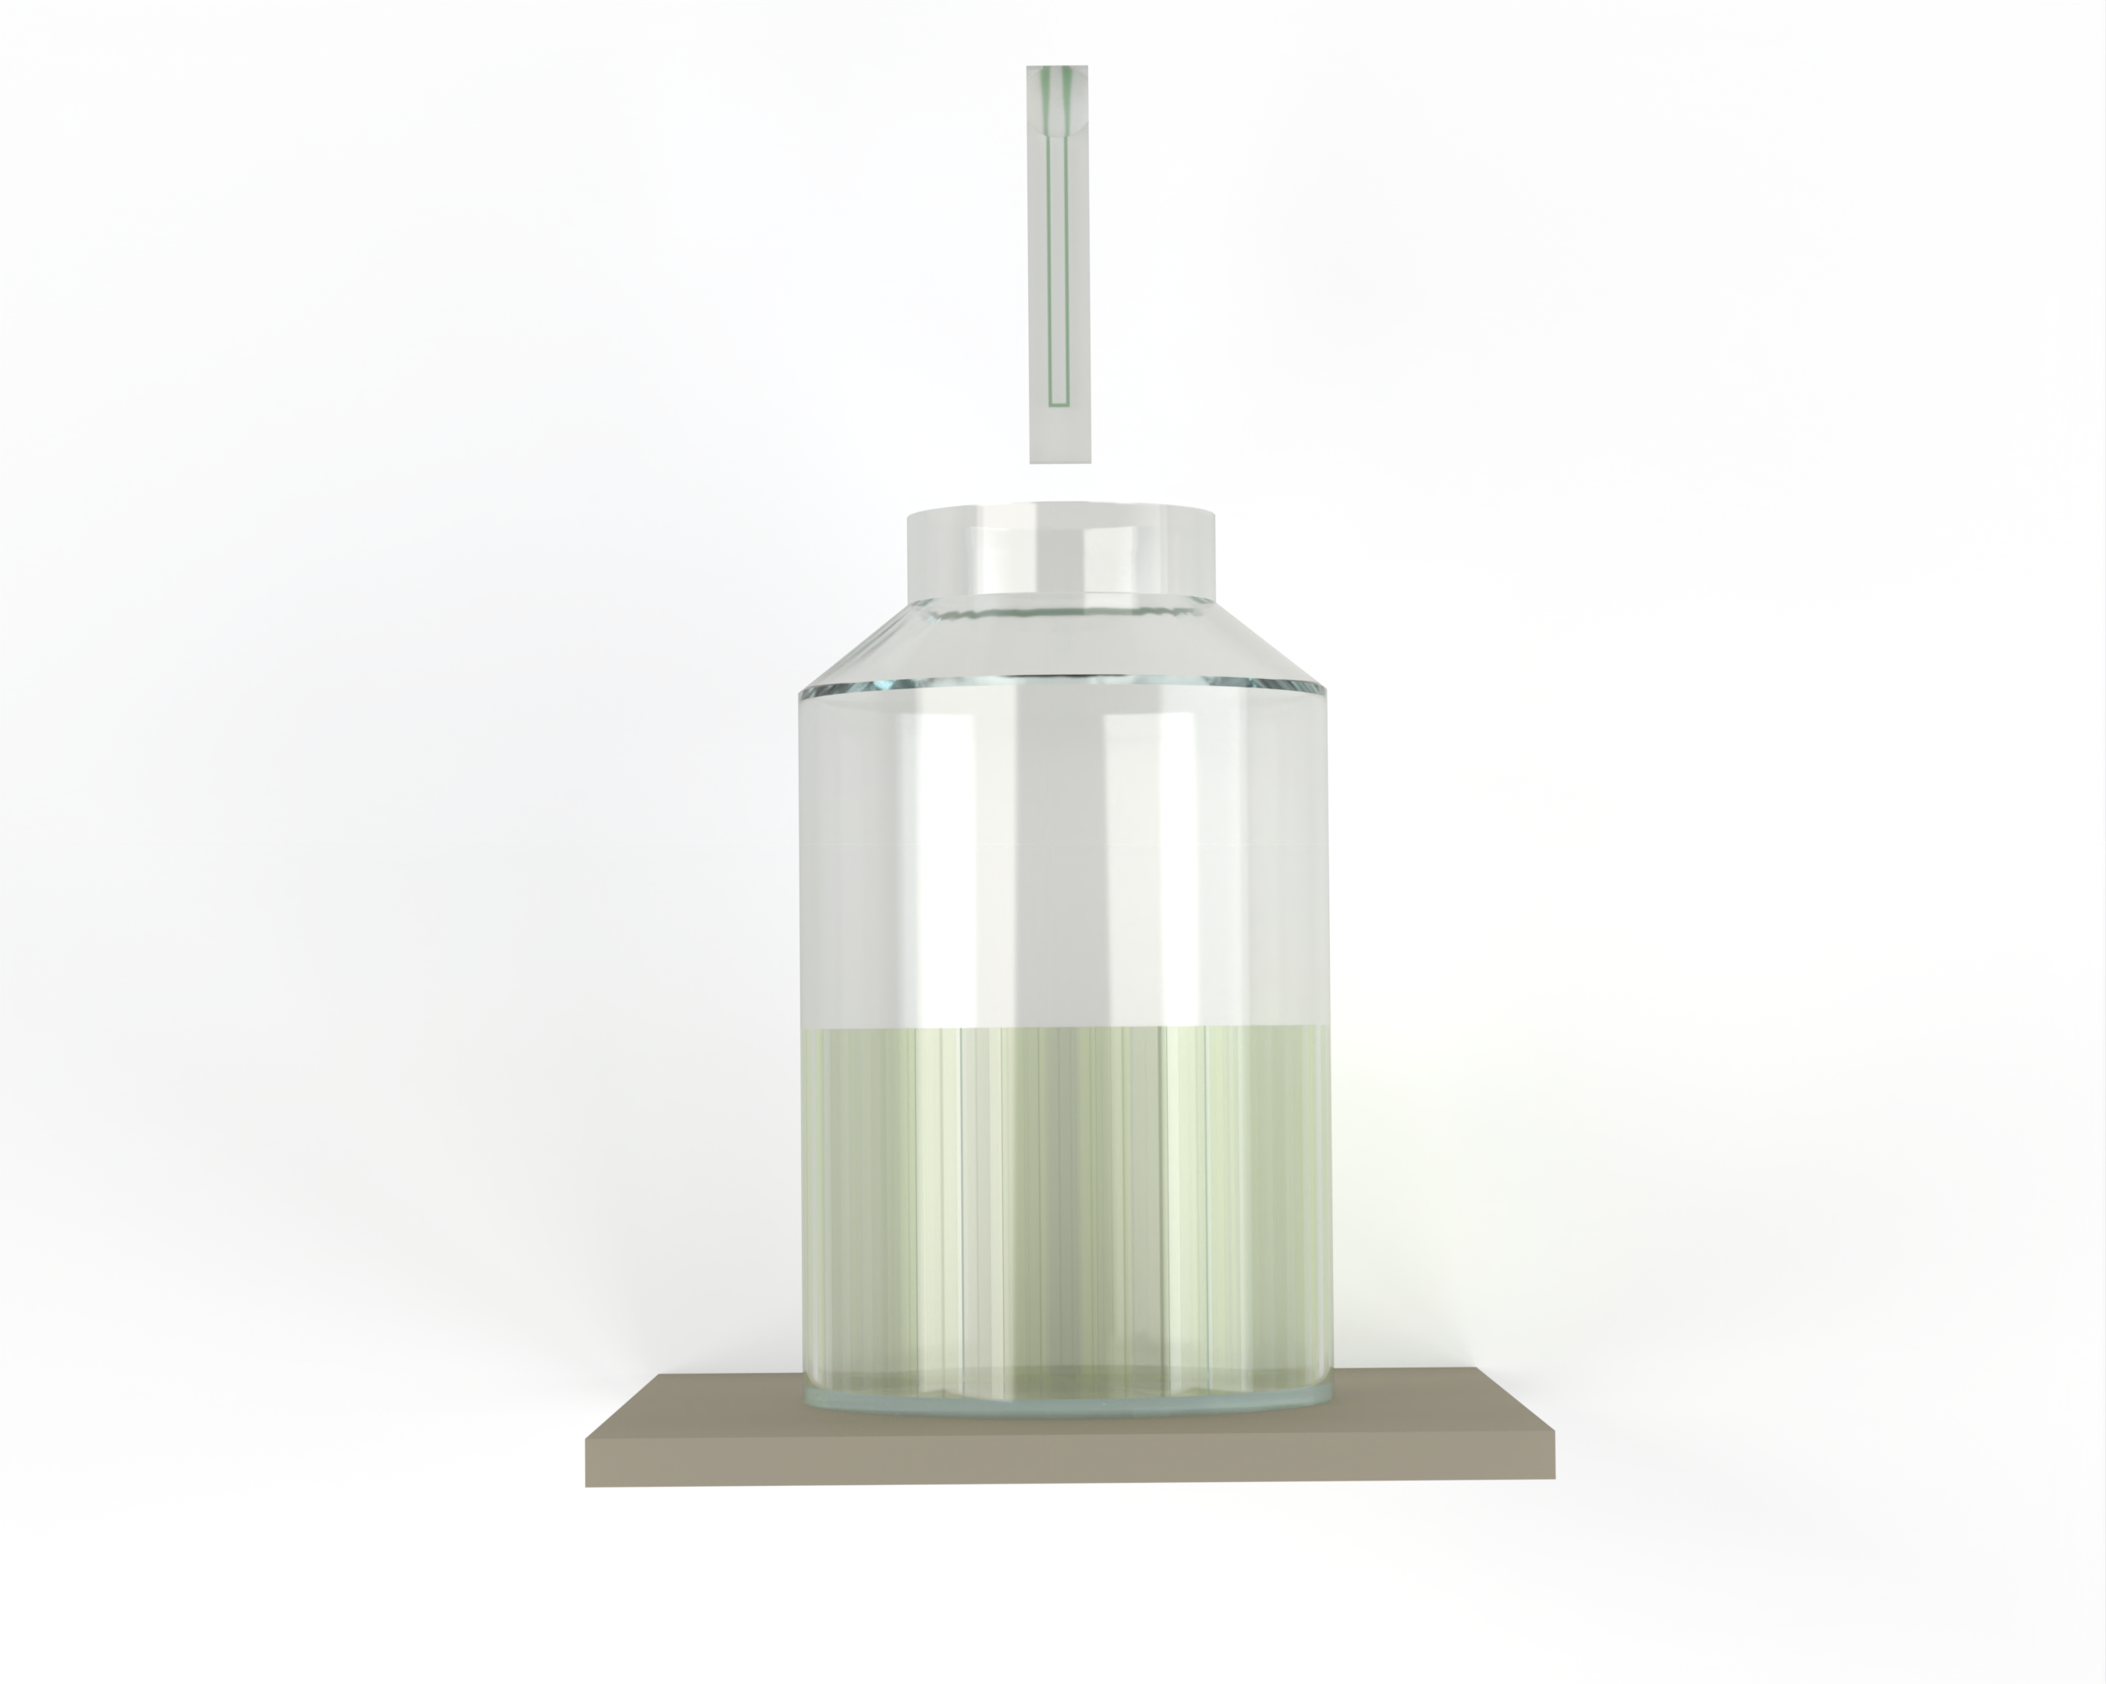
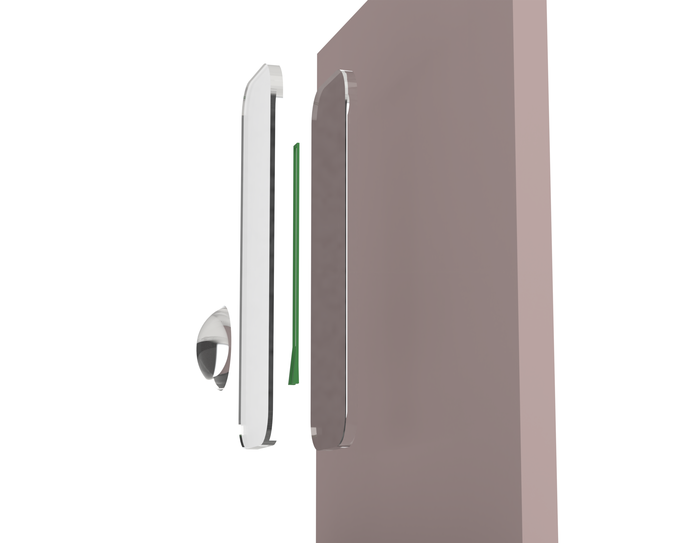
Fabrication Process

